Slide 1
Database Design Using the E-R Model

Slide 2
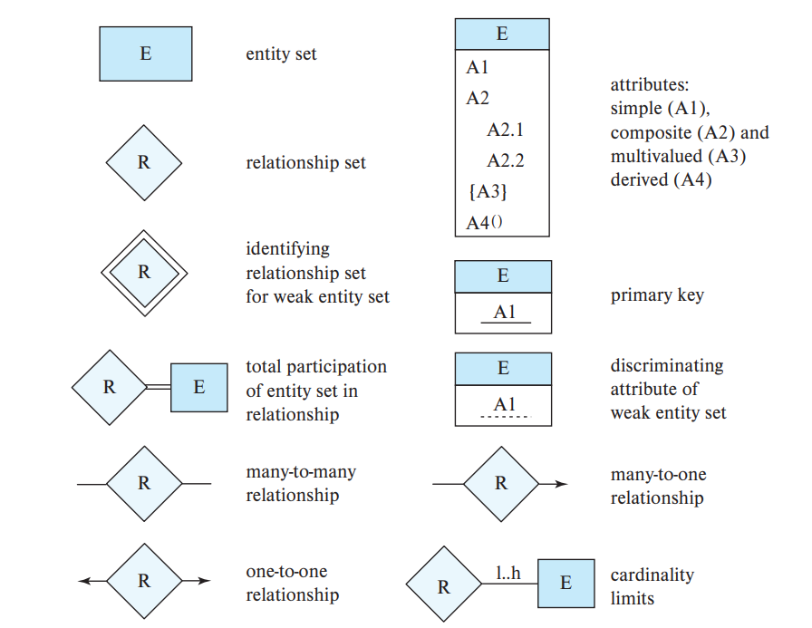

Slide 3
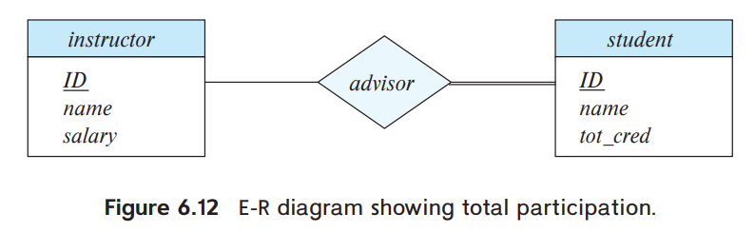
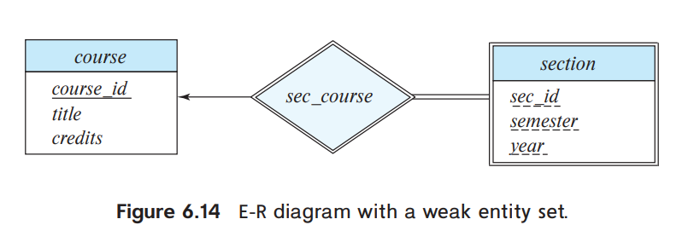

Slide 4
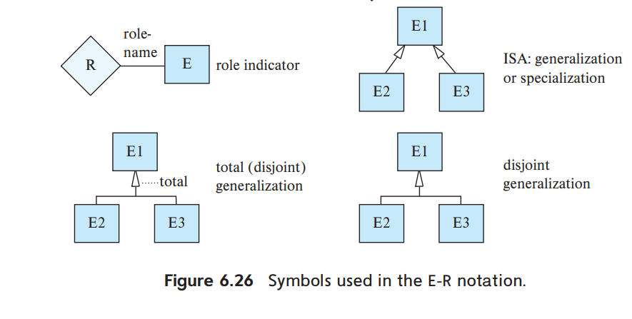

Slide 5
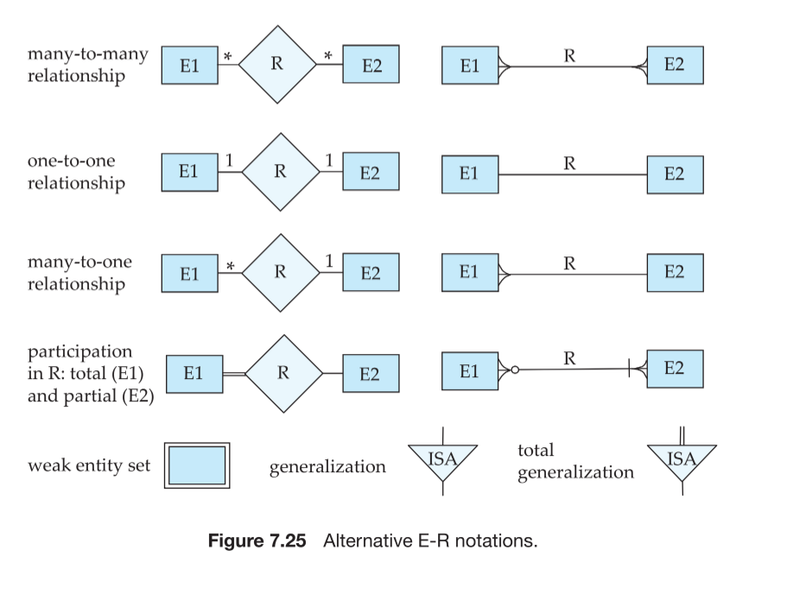

Slide 6
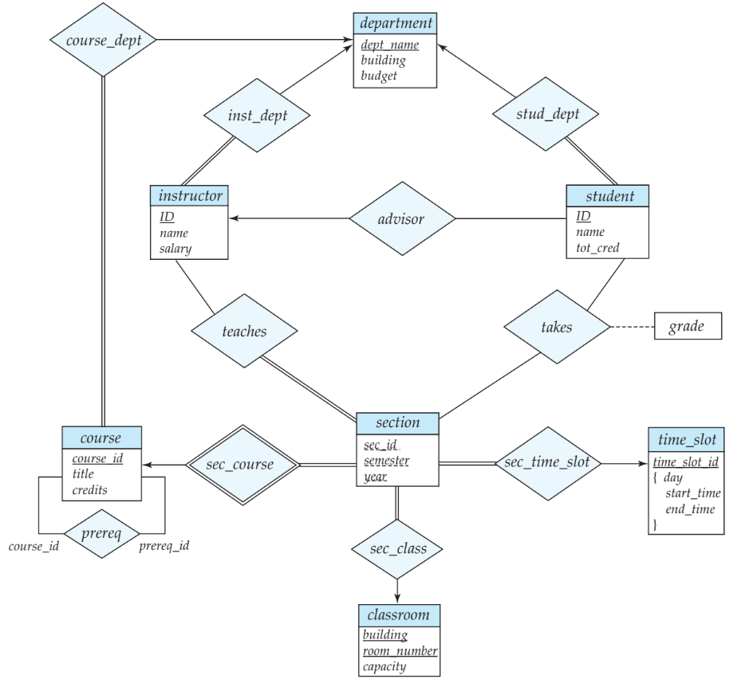
E-R diagram for the University Enterprise

Slide 7
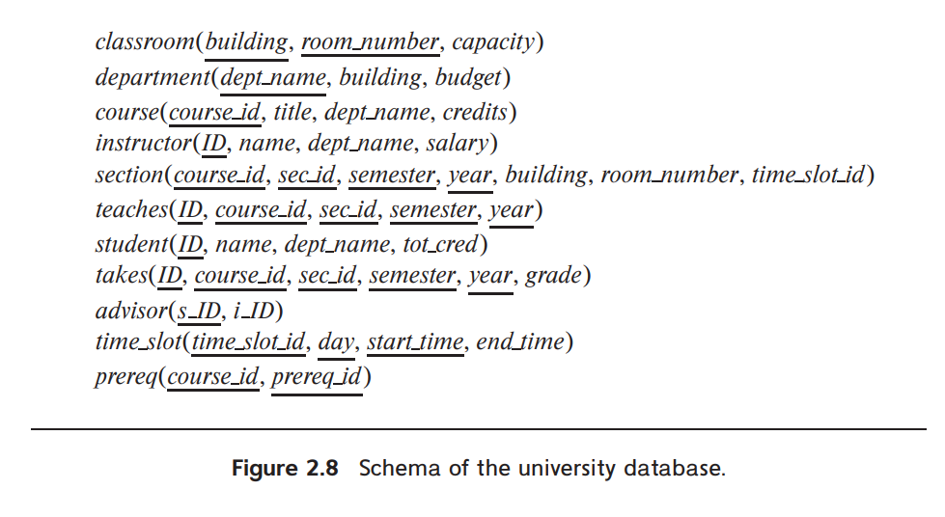
Reduction to Relational Schemas

Slide 8
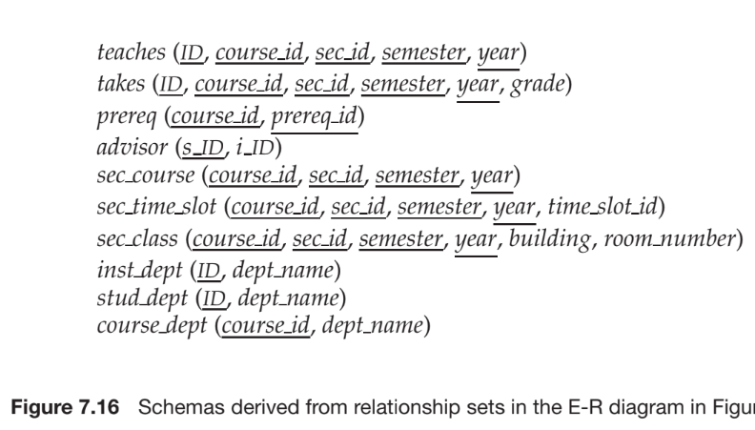

Slide 9
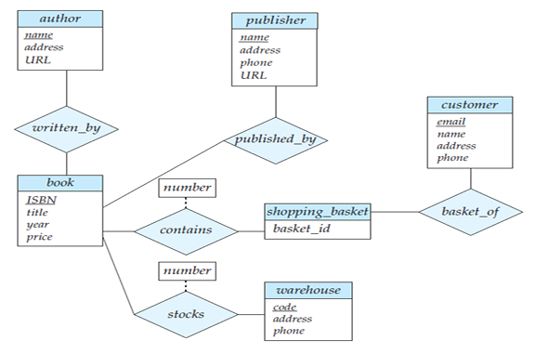
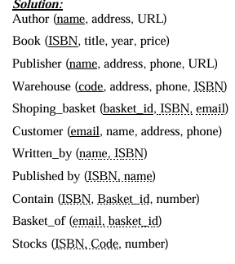
Creating a relational database schema from a ER diagram

Slide 10
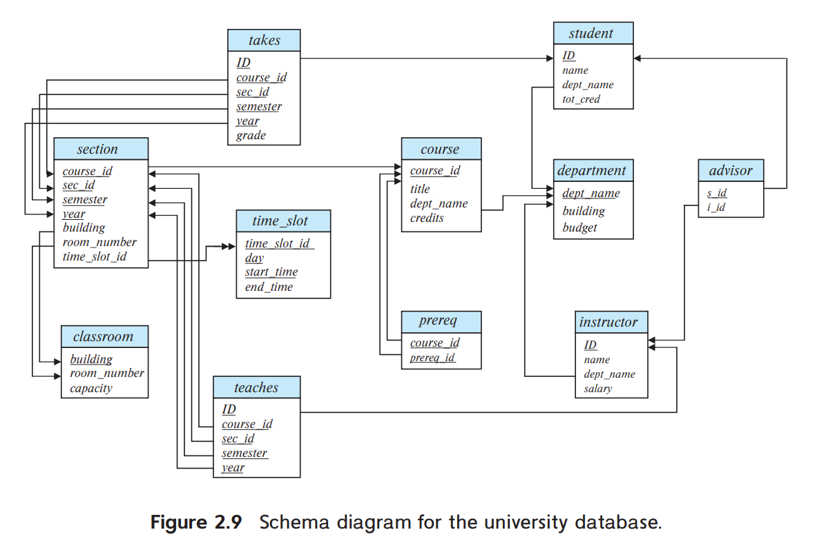
Schema Diagrams

Slide 11
Primary-key attributes are shown underlined.
Foreign-key constraints appear as arrows from the foreign-key attributes of the referencing relation to the primary key of the referenced relation.
We use a two-headed arrow, instead of a single-headed arrow, to indicate a referential integrity constraint that is not a foreign-key constraints.
In Figure 2.9, the line with a two-headed arrow from time slot id in the section relation to time slot id in the time slot relation represents the referential integrity constraint from section. time slot id to time slot.time slot id.

